Slide 1
Reverse Sentiment Analysis
Team 7
Griffin Bishop, Michael Taylor, Alex O'Brien, Aleksa Perucic

Slide 2

The Problem and the Potential
Sentiment analysis uses dictionary of words to predict sentiment
Dictionary contains words weighted towards positive or negative rating
Using Yelp rating to build a sentiment dictionary?
Notes:
Alex O’Brien

Slide 3
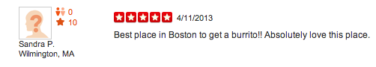
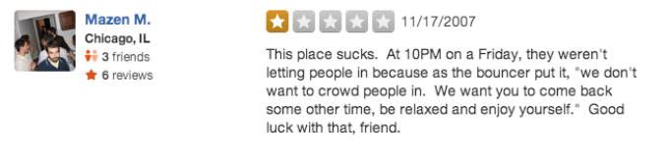
There is an innate correlation between a Yelp reviews rating and the sentiment of words used
Notes:
Alex O’Brien

Slide 4

Valuable for businesses
Could help owners realize shortcomings
Useful alternative to hiring someone to read through Yelp reviews
Notes:
Alex Perucic

Slide 5
Process
Clean the reviews of punctuation
Remove unnecessary words
Use MapReduce to calculate an average score for each word
Use these scores to calculate a predicted score for each review
Notes:
Griffin

Slide 6
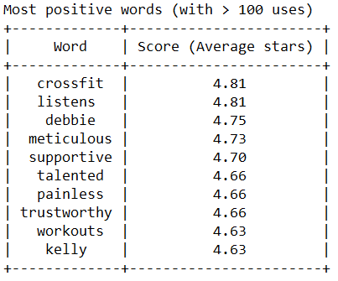
Results - Most Positive Words
Notes:
Griffin

Slide 7
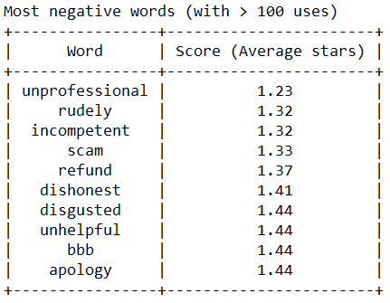
Results - Most Negative Words
Notes:
Griffin

Slide 8
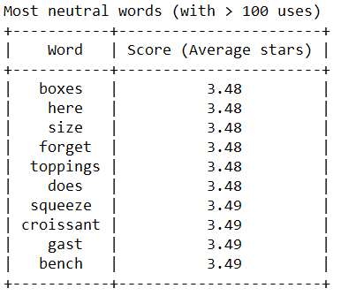
Results - Most Neutral Words
Notes:
Griffin

Slide 9
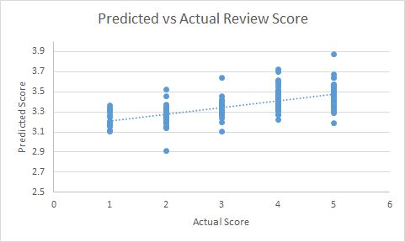
The Data
Most predicted scores revolved between 3 and 4
This is around the “average” review score
Most words in a review are used in a wide range of scores
Brings our prediction towards the “average”
Notes:
Mike

Slide 10
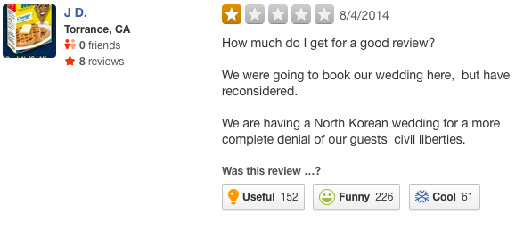
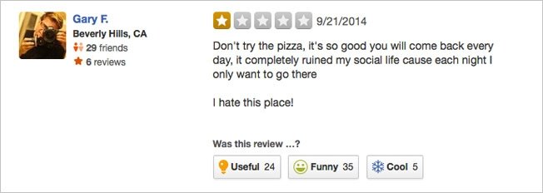
Limitations
Sarcasm
Name of restaurant might skew result (“The Good Restaurant”)
Quotations
Some words are used in multiple contexts
Some review texts do not match the score given
Notes:
Alex Perucic

Slide 11
Questions?

